Slide 1











ASSALAMUWALAIKUM
Welcome to our Project Presentation
Supervised By –
MD. Al Mamun Khan
Lecturer
Department of Computer Science & Engineering
Uttara Institute Of Business And Technology ( UIBT)

Slide 2
PensionProBD
Government Pension Management System
with Role-based Dashboard

Slide 3


Met Our Team
Farzana Akter Liza
Reg: 19502005265
Md. Bappy
Reg: 19502005239

Slide 4
Introduction
The Online Pension Management System is designed to digitalize the entire pension application, verification, and approval workflow. The platform ensures transparency, faster processing, real-time monitoring, and a culturally inspired user interface aligned with Digital Bangladesh initiatives.

Slide 5
Objectives
Speed up pension processing
Ensure transparency
Provide online document submission
Enable role-based dashboards
Support Bangla & English

Slide 6
Existing System
Proposed System
Fully online pension submission
Secure document uploads
Officer-level dashboards
Complaint & Red Flag system
Automated approval workflow
Manual paperwork
Delays & lost files
No real-time tracking
No proper complaint system

Slide 7
Key Features
3 user roles( Pension Holder, Assistant Account,Head of Office)
Multi-step pension form
Status tracking (Pending/Approved/Rejected)
Real-time notifications
Final PDF report download

Slide 8
Pension Holder
Assistant Accountant
Apply online
Upload NID & job documents
View status & officer comments
Submit complaints
Download final report after approval
Verify applications
Approve/forward/reject
Send corrections
3-day rejection window

Slide 9
Head of Office
Handle complaints
Issue Red Flags
Auto-disable after 3 flags
Manage officer accounts

Slide 10
Tools & Technologies
Frontend: React.Js, Tailwind Css
Backend: Node.js ,Express.Js, JWT Authentication
Database: MongoDb

Slide 11
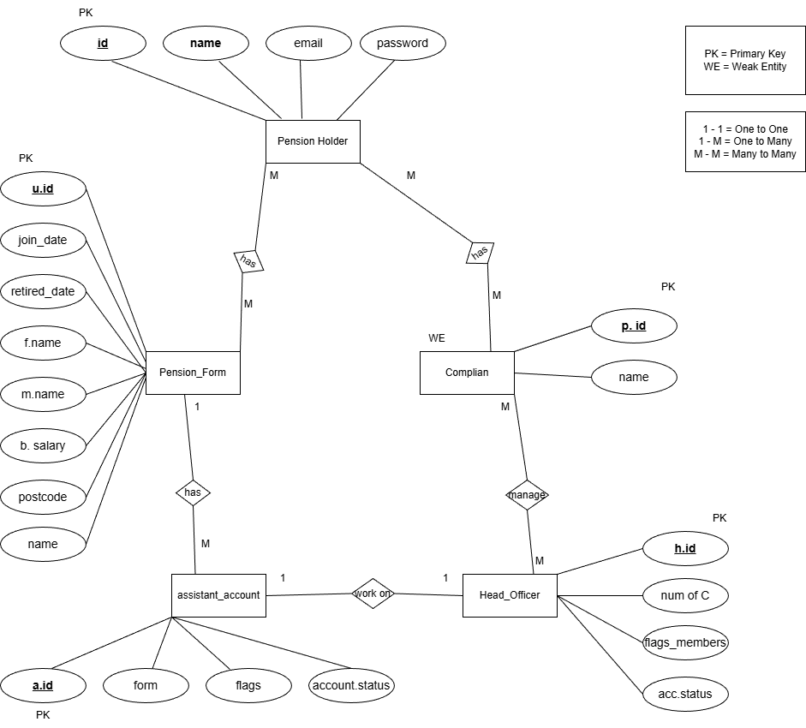
ER Diagram

Slide 12
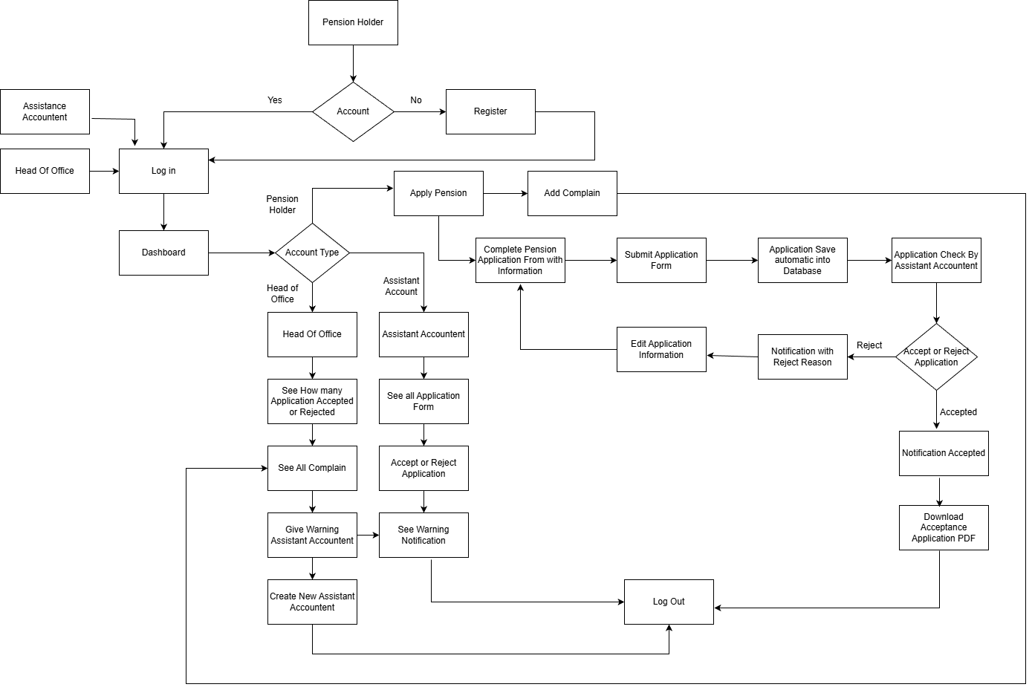
Data Flow Diagram

Slide 13
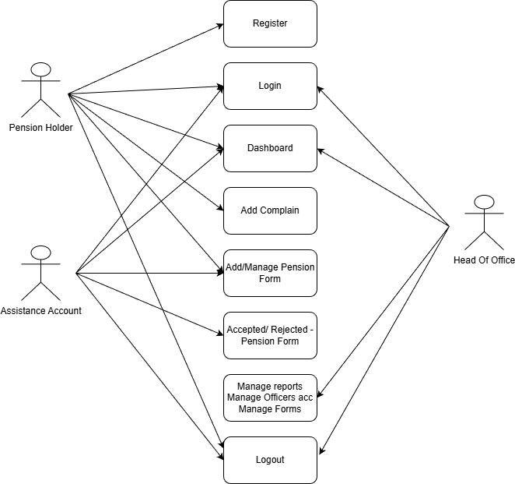
Use Case Diagram

Slide 14
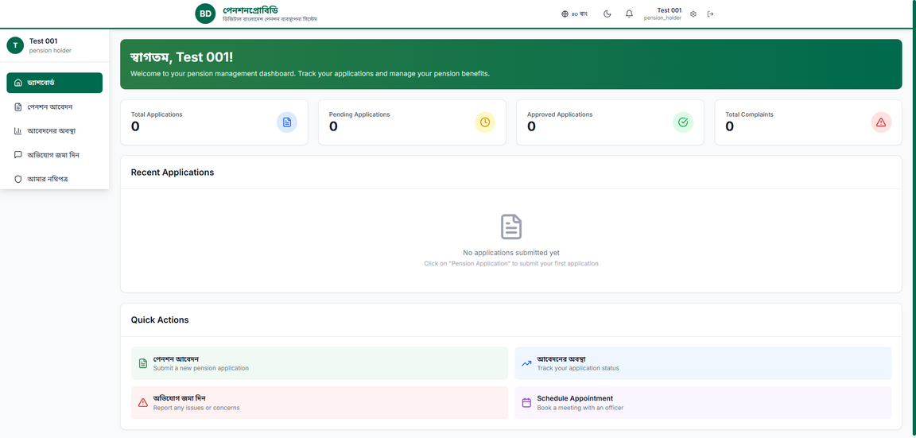
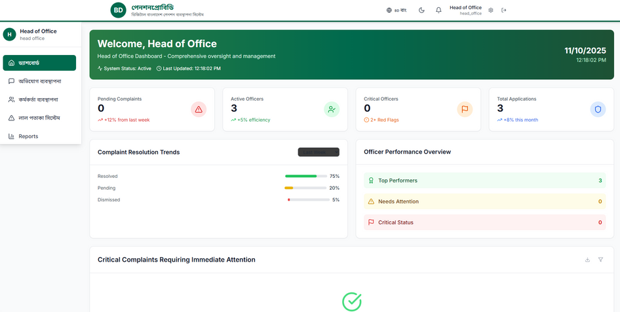
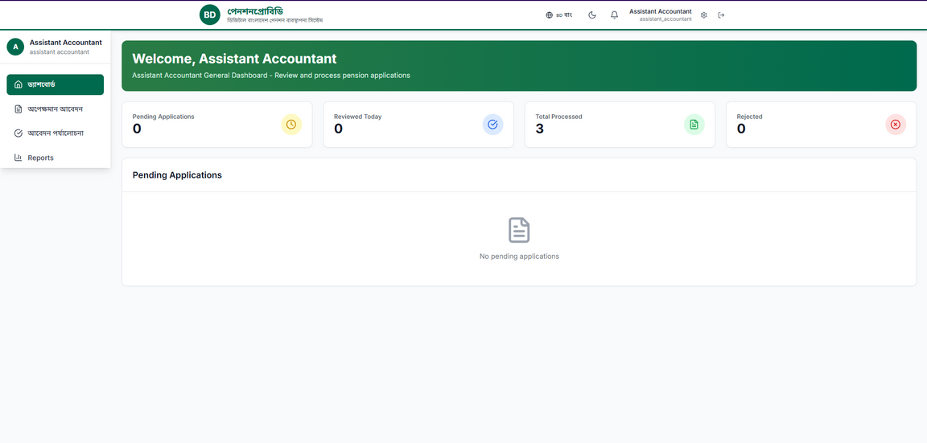
Pension Holder, Account General and Head of Office Dashbord

Slide 15
Future Opportunities
Integration with NID database
SMS alerts
Advanced analytics

Slide 16
THANK YOU VERY MUCH!

